Slide 1
Managing Space for the Database

Slide 2
Objectives
After completing this lesson, you should be able to:
  Describe the concepts and use of 4 KB-sector disks
  Use transportable tablespaces
  Describe the concepts of transportable databases
Notes:
Oracle Database 11g: Administration Workshop II 19 - <number>

Slide 3
Database Storage
Instance
SMON
PMON
RECO
Others
SGA
Database
buffer cache
Redo log
buffer
Shared pool
PGA
Server
process
DBWn
CKPT
LGWR
ARCn
Database
User
process
Control files
Online redo log files
Data files
Archived
log files
Notes:
Database Storage
The database consists of both physical structures and logical structures. Because the physical and logical structures are separate, the physical storage of data can be managed without affecting access to logical storage structures.
Disks, that are a primary storage medium for database, currently have predominantly a sector size of 512 bytes, but the larger, 4 KB-sector disks are beginning to appear on the market, which offer higher storage capacity with a lower overhead. Oracle databases access the hard disk via a platform-specific device driver. (The database writer and log writer [and ASM processes] can write directly to disk without going through the OS.)
Oracle Database 11g Release2 detects the disk sector size and uses high-capacity disks without performance degradation (because of internal optimizations that reduce, for example, potential waste of redo space, which you might expect with applications such as an email system that has many short transactions).

Slide 4
Supporting 4-KB Sector Disks
  Emulation mode:
LBA0 | LBA1 | LBA2 | LBA3 | LBA4 | LBA5 | LBA6 | LBA7
4,096-byte physical sector
  Native mode:
Logical sector
LBA0
4,096-byte physical sector
Physical sector
Notes:
Supporting 4-KB Sector Disks
4-KB sector disks have physical sectors (shown in gray) and logical sectors (shown in blue). There are two types of 4-KB sector disks: emulation mode and native mode.
4-KB sector disks in emulation mode have eight logical sectors per one physical sector (as shown in the slide). They maintain a 512-byte interface to their 4-KB physical sectors—that is, the logical block address (LBA) references 512 bytes on disk.
Performance can be decreased in emulation mode because the disk drive reads the 4 KB sector into disk cache memory, changes the 512-byte section, and then writes the entire 4 KB sector back to disk.
4-KB sector disks in native mode have one logical sector per physical sector (as shown in the slide). So, there is only the 4-KB interface. That is, the LBA references 4,096 bytes on disk.

Slide 5
Using 4-KB Sector Disks
Emulation mode:
  Recommended 4-KB block size for logs
  Recommended 4-KB block size (or larger) for data files
Native mode:
  Mandatory 4-KB block size for logs
  Mandatory 4-KB block size (or larger) for data files
Not affected:
  Control file block size: 16 KB
Database
Control files
Online redo log files
Archived
log files
Data files
Notes:
Using 4-KB Sector Disks
In Oracle Database 11gR2, 4-KB sector disks mainly affect the redo log files. This includes online redo logs, standby redo logs, and archive logs. Oracle recommends that you create 4-KB block size logs on 4-KB emulation mode disks. On 4-KB native mode disks, you must create 4-KB block size logs.
That is, the redo block size must match the physical disk sector size (for 512-byte and for 4-KB native mode disks). Otherwise, you receive the ORA-1378 error. For 4-KB emulation mode disks, the redo block size could be 512 or 4,096 bytes. 4 KB is the preferred block size. When you are creating 512-byte blocks on a 4-KB emulation disk, a warning is printed to the alert log to indicate that the mismatched block size leads to degraded performance. This also applies to ASM disk groups.
The 4-KB sector disks also affect the Oracle data file. The Oracle database allows you the creation of 2-KB block size data files on 512-byte sector disks. With 4-KB sector disks, Oracle recommends that you create 4-KB (or larger) block size data files on the 4-KB emulation mode disks. On 4-KB native mode disks, you must create 4-KB block (or larger) size logs.
The control file block size is already 16 KB. Therefore, the 4-KB sector disks do not affect the control file.

Slide 6
Specifying the Disk Sector Size
Using the SECTOR_SIZE and BLOCKSIZE clauses of the following commands:
  CREATE DISKGROUP
  ALTER DATABASE
  CREATE DATABASE
  CREATE CONTROL FILE
Default sector size based on hardware (not the earlier 512-byte sectors)
CREATE DATABASE sample NORESETLOGS FORCE LOGGING ARCHIVELOG
LOGFILE
GROUP 1 '$ORACLE_BASE/oradata/sample/redo01.log'
SIZE 100M BLOCKSIZE 4096,
GROUP 2 '$ORACLE_BASE/oradata/sample/redo02.log‘
SIZE 100M BLOCKSIZE 4096
DATAFILE
...
Notes:
Specifying the Disk Sector Size
In an Automatic Storage Management (ASM) environment, you can set the SECTOR_SIZE attribute for disk groups. This attribute can be set only at disk group creation time (by using the CREATE DISKGROUP command).
You can specify the size of the log file with the new BLOCKSIZE clause for the following commands:
ALTER DATABASE
CREATE DATABASE
CREATE CONTROL FILE
There is no additional work for you when you create a new database on 4-KB sector disks compared to creating a new database on 512-byte disks. There is no change in the GUI environments.
You have the option of using the BLOCKSIZE clause in the CREATE DATABASE command, as shown in the slide. When you do not specify a block size, the Oracle database discovers the underlying disk sector size and uses the disk sector size as the block size for the redo log creation. So by default, the redo log block size is the disk sector size, not the earlier 512-byte sector size.

Slide 7
Quiz
You must use 4-KB log files on 4-KB native mode disks.
  True
  False
Notes:
Answer: 1

Slide 8
Quiz
Oracle recommends that you create 512-byte blocks on a 4-KB emulation disk for performance reasons.
  True
  False
Notes:
Answer: 2

Slide 9
Quiz
Control files are not affected by 4-KB sector disks (because they are already larger).
  True
  False
Notes:
Answer: 1

Slide 10
Transporting Tablespaces
  Cross-platform transportable tablespaces:
    Simplify moving data between data warehouse and data marts
    Allow database migration from one platform to another
  Supported platforms include:
Solaris[tm] OE (32-bit)
HP-UX (64-bit)
Microsoft Windows IA (64-bit)
Solaris[tm] OE (64-bit)
HP Tru64 UNIX
IBM zSeries Based Linux
Microsoft Windows IA (32-bit)
HP-UX IA (64-bit)
Linux 64-bit for AMD
Linux IA (32-bit)
Linux IA (64-bit)
Apple Mac OS
AIX-Based Systems (64-bit)
HP Open VMS
Microsoft Windows 64-bit AMD
IBM Power Based Linux
HP IA Open VMS
Solaris x86 and AMD64
Notes:
Oracle Database 11g: Administration Workshop II 19 - <number>
Transporting Tablespaces
Transportable tablespace is the fastest way for moving large volumes of data between two Oracle databases. Using transportable tablespaces, Oracle data files (containing table data, indexes, and almost every other Oracle database object) can be directly transported from one database to another. Furthermore, like import and export, transportable tablespaces provide a mechanism for transporting metadata in addition to transporting data.
You can use the transportable tablespace feature to move data across platform boundaries. This simplifies the distribution of data from a data warehouse environment to data marts, which often run on smaller platforms. It also allows a database to be migrated from one platform to another by rebuilding the dictionary and transporting the user tablespaces.
Moving data using transportable tablespaces is much faster than performing either an export/import or unload/load of the same data. This is because the data files containing all of the actual data are just copied to the destination location, and you use Data Pump to transfer only the metadata of the tablespace objects to the new database.
To be able to transport data files from one platform to another, you must ensure that both the source system and the target system are running on one of the supported platforms (see slide).
Note: The cross-platform transportable tablespace feature requires both platforms to be using the same character sets.

Slide 11

Concept: Minimum Compatibility Level
  Both source and target databases must have COMPATIBLE set to 10.0.0 or higher.
  Data file headers are platform-aware.
  Before transporting, make sure that all read-only and offline files are platform-aware.
Read/
write
Read/
write
Read-
only
Read-
only
Read/
write
Read-
only
COMPATIBLE=9.2.0
COMPATIBLE=10.0.0
Notes:
Oracle Database 11g: Administration Workshop II 19 - <number>
Concept: Minimum Compatibility Level
Both source and target databases need to advance their database COMPATIBLE initialization parameter to 10.0.0 or greater before they can use the cross-platform transportable tablespace feature.
When data files are first opened under Oracle Database 10g or 11g with COMPATIBLE set to 10.0.0 (or greater), the files are made platform-aware. This is represented by the check marks in the diagram. Each file identifies the platform that it belongs to. These files have identical on-disk formats for file header blocks that are used for file identification and verification. Read-only and offline files get the compatibility advanced only after they are made read/write or are brought online. This implies that tablespaces that are read-only in databases before Oracle Database 10g must be made read/write at least once before they can use the cross-platform transportable feature.

Slide 12
Minimum Compatibility Level
        Minimum Compatibility Setting
        Source Database Target Database
Transport Scenario
Databases on the same platform 8.0 8.0
Tablespace with different database block 9.0 9.0
size than the target database
Databases on different platforms 10.0 10.0
Notes:
Oracle Database 11g: Administration Workshop II 19 - <number>
Minimum Compatibility Level
When you create a transportable tablespace set, Oracle Database computes the lowest compatibility level at which the target database must run. This is referred to as the compatibility level of the transportable set. Beginning with Oracle Database 11g, a tablespace can always be transported to a database with the same or higher compatibility setting, whether the target database is on the same or a different platform. The database signals an error if the compatibility level of the transportable set is higher than the compatibility level of the target database.
The above table shows the minimum compatibility requirements of the source and target tablespace in various scenarios. The source and target database need not have the same compatibility setting.
When data files are first opened, each file identifies the platform that it belongs to. These files have identical on-disk formats for file header blocks that are used for file identification and verification. Read-only and offline files get the compatibility advanced only after they are made read/write or are brought online.

Slide 13
Transportable Tablespace Procedure
Source
Make tablespaces read-only.
Use Data Pump to extract metadata.
Target
uses the same
endian format?
No
Convert data files
by using RMAN.
Yes
Ship data files and dump file to target.
Use Data Pump to import metadata.
Target
Make tablespaces read/write.
Notes:
Oracle Database 11g: Administration Workshop II 19 - <number>
Transportable Tablespace Procedure
To transport a tablespace from one platform to another (source to target), data files belonging to the tablespace set must be converted to a format that can be understood by the target or destination database. Although with Oracle Database, disk structures conform to a common format, it is possible for the source and target platforms to use different endian formats (byte ordering). When going to a different endian platform, you must use the CONVERT command of the RMAN utility to convert the byte ordering. This operation can be performed on either the source or the target platforms. For platforms that have the same endian format, no conversion is needed.
The slide graphic depicts the possible steps to transport tablespaces from a source platform to a target platform. However, it is possible to perform the conversion after shipping the files to the target platform. The last two steps must be executed on the target platform.
Basically, the procedure is the same as when using previous releases of the Oracle database server except when both platforms use different endian formats. It is assumed that both platforms are cross-transportable compliant.
Note: Byte ordering can affect the results when data is written and read. For example, the 2-byte integer value 1 is written as 0x0001 on a big-endian system (such as Sun SPARC Solaris) and as 0x0100 on a little-endian system (such as an Intel-compatible PC).

Slide 14
Determining the Endian Format of a Platform
SELECT tp.endian_format
FROM v$transportable_platform tp, v$database d
WHERE tp.platform_name = d.platform_name;
Source
Target
Notes:
Oracle Database 11g: Administration Workshop II 19 - <number>
Determining the Endian Format of a Platform
You can query V$TRANSPORTABLE_PLATFORM to determine whether the endian ordering is the same on both platforms. V$DATABASE has two columns that can be used to determine your own platform name and platform identifier. Run the query below for a comprehensive list of supported platforms and their endian formats:
SQL> SELECT * FROM V$TRANSPORTABLE_PLATFORM;
PLATFORM_ID PLATFORM_NAME ENDIAN_FORMAT
----------- -------------------------------- --------------
1 Solaris[tm] OE (32-bit) Big
2 Solaris[tm] OE (64-bit) Big
7 Microsoft Windows IA (32-bit) Little
10 Linux IA (32-bit) Little
6 AIX-Based Systems (64-bit) Big
3 HP-UX (64-bit) Big
5 HP Tru64 UNIX Little
4 HP-UX IA (64-bit) Big
11 Linux IA (64-bit) Little
15 HP Open VMS Little

Slide 15
Notes:
Determining the Endian Format of a Platform (continued)
PLATFORM_ID PLATFORM_NAME ENDIAN_FORMAT
----------- -------------------------------- --------------
8 Microsoft Windows IA (64-bit) Little
9 IBM zSeries Based Linux Big
13 Linux 64-bit for AMD Little
16 Apple Mac OS Big
12 Microsoft Windows 64-bit for AMD Little
17 Solaris Operating System (x86) Little
18 IBM Power Based Linux Big
19 HP IA Open VMS Little
20 Solaris Operating System (AMD64) Little

Slide 16
Using the RMAN CONVERT Command
RMAN:
  Converts tablespaces, data files, or databases to the format of a destination platform
  Does not change input files
  Writes converted files to output destination
CONNECT TARGET SYS@orcl
RMAN>
SQL 'ALTER TABLESPACE hr READ ONLY';
CONVERT TABLESPACE hr
TO PLATFORM 'Solaris[tm] OE (64-bit)'
FORMAT '/tmp/transport_to_solaris/%U';;
Notes:
Using the RMAN CONVERT Command
You use the RMAN CONVERT command to convert a tablespace, data file, or database to the format of a destination platform in preparation for transport across different platforms. Input files are not altered by CONVERT because the conversion is not performed in place. Instead, RMAN writes converted files to a specified output destination.
CONVERT TABLESPACE example:
Assume that you have an ORCL database on a Linux 32-bit platform, which you want to transport to a Solaris 64-bit platform.
Connect as TARGET to the source database (mounted or open).
The tablespace must be read-only at the time of conversion.
The result is a set of converted data files in the /tmp/transport_to_solaris/ directory, with data in the right endian-order for the Solaris 64-bit platform.
Restrictions: The CONVERT command does not process user data types that require endian conversions. To transport objects between databases that are built on underlying types that store data in a platform-specific format, use the Data Pump Import and Export utilities.
For detailed prerequisites, usage, restrictions, and syntax, see the Oracle Database Backup and Recovery Reference.

Slide 17
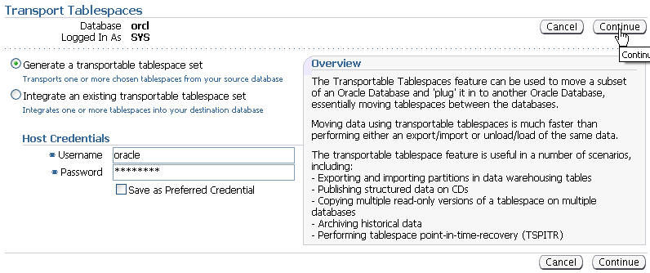
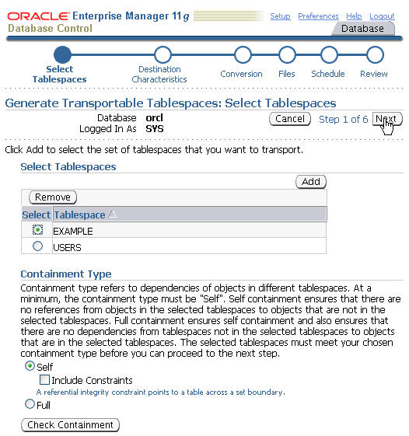
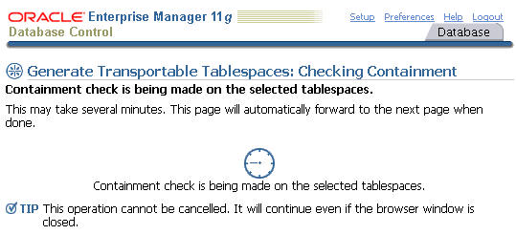
Transportable Tablespaces with
Enterprise Manager
Notes:
Transportable Tablespaces with Enterprise Manager
Enterprise Manager can be used to implement transportable tablespaces. From the Database home page, click the Data Movement folder tab, and then click Transport Tablespaces under the Move Database Files section. Select “Generate a transportable table set” and provide the login credentials for the oracle user, and then click Continue. On the Select Tablespaces page, add the tablespaces you want to transport from the displayed list by clicking the Tablespace button, and then clicking Add. Near the bottom of the page, you must select the level of containment checking to be done before the tablespaces are processed. The containment check looks for object dependencies within the tablespaces. When you have finished, click Next. Wait a few moments while the containment check runs. Address any issues found by the check before continuing.

Slide 18
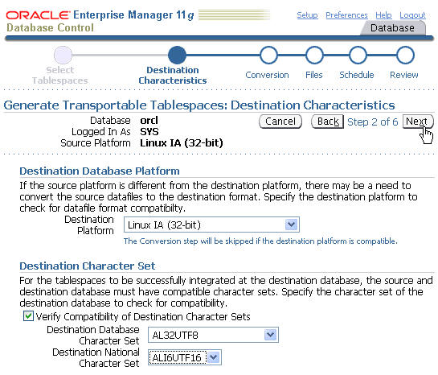
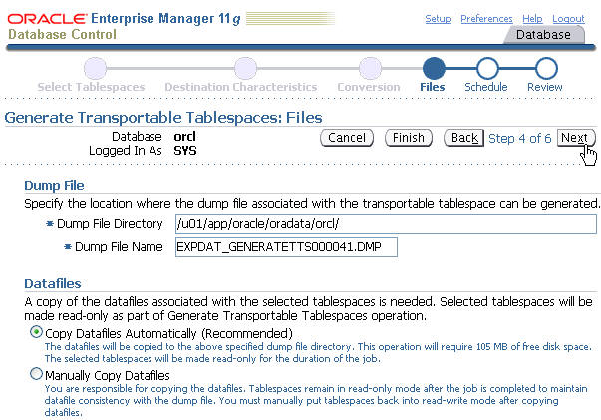
Transportable Tablespaces with
Enterprise Manager
Notes:
Transportable Tablespaces with Enterprise Manager (continued)
On the Destination Characteristics page, you must supply the destination platform and character sets. Under the Destination Database Platform section, select the operating system of the destination machine from the drop-down list. If the destination platform is different from the source platform, Enterprise Manger will perform a data conversion. Continue to the Destination Character Set section of the page and choose the destination character set and national character set from the drop-down lists. These character sets must be compatible with the source sets. When you click Next to continue, Enterprise Manager checks the compatibility of the character sets. If the chosen character sets are flagged as incompatible, you will be returned back to the Destination Characteristics page to correct your selections.

Slide 19
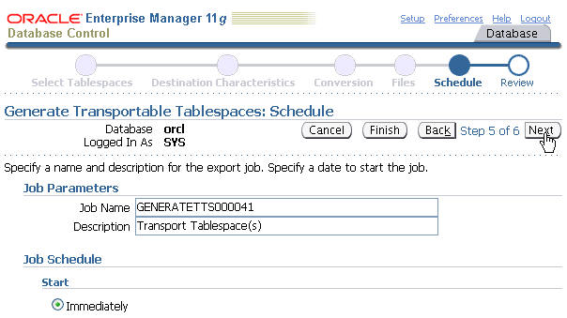
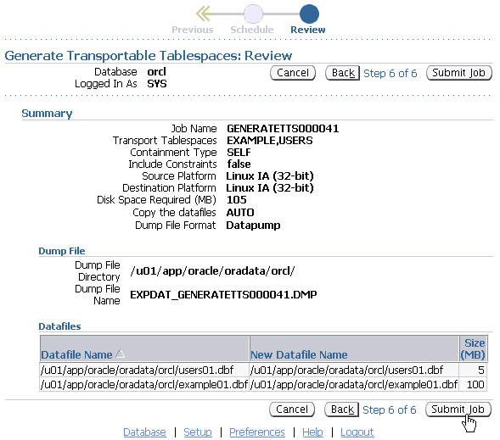
Transportable Tablespaces with
Enterprise Manager
Notes:
Transportable Tablespaces with Enterprise Manager (continued)
On the Schedule page, supply a meaningful description for the default job name. You can also choose to start the job immediately or schedule it for later execution. When you have made your selections, click Next to continue. On the review page, you can verify your choices before submitting the job for execution. Click the Submit Job button if the entries are correct. Click the Back button to correct any incorrect entries.

Slide 20
Transporting Databases
  Generalize the transportable tablespace feature.
  Data subsets can easily be distributed from a data warehousing environment to data marts, which are usually on smaller platforms.
  A database can be migrated from one platform to another very quickly.
Platform X
Same “endianness”
Platform Y
Database files transfer
Existing database
New database
Notes:
Oracle Database 11g: Administration Workshop II 19 - <number>
Transporting Databases
You can use the transportable tablespace feature to migrate a database to a different platform by creating a new database on the destination platform and performing a transport of all the user tablespaces. You cannot transport the SYSTEM tablespace. Therefore, objects such as sequences, PL/SQL packages, and other objects that depend on the SYSTEM tablespace are not transported. You must either create these objects manually on the destination database, or use Data Pump to transport the objects that are not moved by transportable tablespace.
To transport databases from one platform to another, you must ensure that both the source system and the target system are running on one of the platforms that are listed in V$TRANSPORTABLE_PLATFORM and that both have the same endian format. For example, you can transport a database running on Linux IA (32-bit) to one of the Windows platforms.
If one or both of the databases uses Automatic Storage Management (ASM), you may need to use the DBMS_FILE_TRANSFER package to FTP the files.
Unlike transportable tablespace, where there is a target database to plug data into, this feature creates a new database on the target platform. The newly created database contains the same data as the source database. Except for things such as database name, instance name, and location of files, the new database also has the same settings as the source database.
Note: Transporting database is faster than using Data Pump to move data.

Slide 21
Database Transportation Procedure:
Source System Conversion
Open database in READ ONLY mode
and COMPATIBLE=10.0.0 or higher.
Ship
files
Read-
only
Read-
only
Read-
only
Read-
only
CONVERT
DATABASE
TO PLATFORM
Source
system
Target
system
Notes:
Oracle Database 11g: Administration Workshop II 19 - <number>
Database Transportation Procedure: Source System Conversion
Before you can transport your database, you must open it in READ ONLY mode. Then use RMAN to convert the necessary data files of the database.
When you do the conversion on the source platform, the RMAN CONVERT DATABASE command generates a script containing the correct CREATE CONTROLFILE RESETLOGS command that is used on the target system to create the new database. The CONVERT DATABASE command then converts all identified data files so that they can be used on the target system. You then ship the converted data files and the generated script to the target platform. By executing the generated script on the target platform, you create a new copy of your database.
Note: The source database must be running with the COMPATIBLE initialization parameter set to 10.0.0 or higher. All identified tablespaces must have been READ WRITE at least once since the time that COMPATIBLE was set to 10.0.0 or higher.

Slide 22
Database Transportation Procedure:
Target System Conversion
Open database in READ ONLY mode
and COMPATIBLE=10.0.0 or higher
CONVERT
DATABASE
ON DESTINATION
PLATFORM
Read-
only
Read-
only
Read-
only
Read-
only
Ship
files
Source
system
Target
system
Notes:
Oracle Database 11g: Administration Workshop II 19 - <number>
Database Transportation Procedure: Target System Conversion
Before you can transport your database, you must open it in READ ONLY mode. Then use RMAN to convert the necessary data files of the database.
When you do the conversion on the target platform, the CONVERT DATABASE command (which is executed on the source system) generates only two scripts used on the target system to convert the data files, and to re-create the control files for the new database. Then, you ship the identified data files and both scripts to the target platform. After this is done, execute both scripts in the right order. The first one uses the existing RMAN CONVERT DATAFILE command to do the conversion, and the second issues the CREATE CONTROLFILE RESETLOGS SQL command with the converted data files to create the new database.
Note: The source database must be running with the COMPATIBLE initialization parameter set to 10.0.0 or higher. All identified tablespaces must have been READ WRITE at least once since COMPATIBLE was set to 10.0.0 or higher.

Slide 23
Database Transportation: Considerations
  Create the password file on the target platform.
  Transport the BFILEs used in the source database.
  The generated PFILE and transport script use OMF.
  Use DBNEWID to change the DBID.
Notes:
Oracle Database 11g: Administration Workshop II 19 - <number>
Database Transportation: Considerations
Redo logs, control files, and tempfiles are not transported. They are re-created for the new database on the target platform. As a result, the new database on the target platform must be opened with the RESETLOGS option.
If a password file is used, it is not transported and you need to create it on the target platform. This is because the types of file names allowed for the password file are OS specific. However, the output of the CONVERT DATABASE command lists all the usernames and their system privileges, and advises to re-create the password file and add entries for these users on the target platform.
The CONVERT DATABASE command lists all the directory objects and objects that use BFILE data types or external tables in the source database. You may need to update these objects with new directory and file names. If BFILEs are used in the database, you have to transport the BFILEs.
The generated PFILE and transport script use Oracle Managed Files (OMF) for database files. If you do not want to use OMF, you must modify the PFILE and transport script.
The transported database has the same DBID as the source database. You can use the DBNEWID utility to change the DBID. In the transport script as well as the output of the CONVERT DATABASE command, you are prompted to use the DBNEWID utility to change the database ID.

Slide 24
Quiz
Select the statements that are true:
  The RMAN CONVERT command performs an in-place conversion, so your input files are changed before they are transported to the destination.
  Read/write tablespaces need to be in read-only mode at the time of an endian conversion.
  You can use the RMAN CONVERT command for tables, tablespaces, and databases.
  You can transport databases into a data warehouse environment.
Notes:
Answer: 2, 4

Slide 25
Summary
In this lesson, you should have learned how to:
  Describe the concepts and use of 4 KB-sector disks
  Describe the concepts of transportable tablespaces and databases
Notes:
Oracle Database 11g: Administration Workshop II 19 - <number>

Slide 26
Practice 19 Overview:
Managing Space for the Database
This practice covers the following topic:
  Viewing a demonstration on “Using 4 KB-sector disks”
Notes:
Oracle Database 11g: Administration Workshop II 19 - <number>

